Slide 1


.NET Core
SURESH KANCHAMREDDY, ANIMESH BULUSU, KUMAR UPPE, SRAVAN GUMPENA, MAHESH PULLAGURA, MAHESH GALI, RAJESH PRASAD
July 2019

Slide 2
AGENDA
Introduction
dotnet CLI, packages and deployment
Middleware and Dependency Injection
ASP.NET Core with MVC #1
ASP.NET Core with MVC #2
ASP.NET Core Advanced Topics
Web API
Conclusion
Notes:
Internationalization

Slide 3
Topic List
Introduction
Getting Started
Application Startup
Future direction
dotnet CLI
Versioning, packages
Deployment
Middleware
Dependency Injection
Introduction
MVC
Routing
CSRF
Model Binding
Razor
Tag Helpers
Filters
Formatters
Compression
Caching
Web API
CORS
Best practices
Q and A

Slide 4
INTRODUCTION
.NET Core is an open-source, cross-platform framework for building modern, cloud-based web applications on Windows, macOS, or Linux.
A cloud and environment-based configuration system.
Built-in dependency injection.
Testability(Unit testing)
Ability to host on IIS, Apache, Docker or self-host in your own process.
Build web APIs and web UI using ASP.NET Core MVC
Can Integrate with any client-side technology.
Editors support:- VS, VS Code, Sublime, Vim, Atom

Slide 5
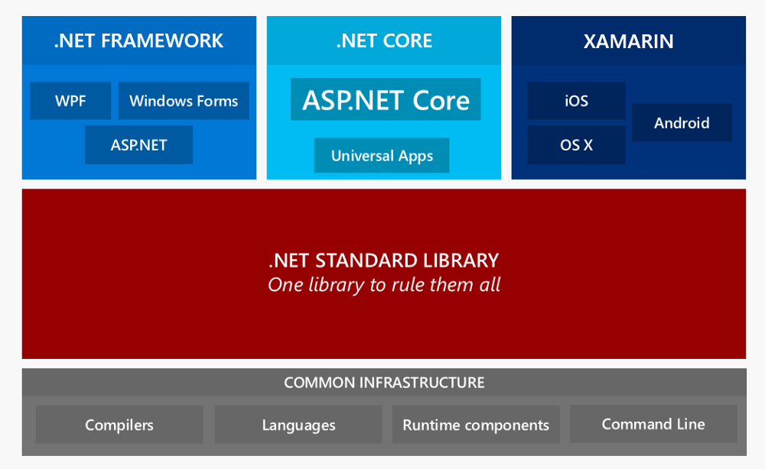
.NET ECOSYSTEM ARCHITECTURE

Slide 6
BRIEF ABOUT RUNTIMES
.NET Framework: The most well-known runtime is the .NET Framework. You can build more application types with the .NET Framework, but the types are mainly Windows-centric.
.NET Core: Then there is the .NET Core runtime which has cross-platform support. Can be used to create ASP.NET Core and Universal Windows Platform (UWP) applications. And it is optimized for performance.
Mono for Xamarin: Finally, there is the Mono runtime, which is used by Xamarin applications. The Mono runtime itself is a cross-platform implementation of the .NET Framework and it can run all sorts of applications, like console and Windows Forms applications.

Slide 7
.NET Standard Library
.NET Standard solves the code sharing problem for .NET developers across all platforms by bringing all the APIs that you expect and love across the environments that you need: desktop applications, mobile apps & games, and cloud services:
.NET Standard is a set of APIs that all .NET platforms must implement. This unifies the .NET platforms and prevents future fragmentation.
.NET Standard 2.0 will be implemented by .NET Framework, .NET Core, and Xamarin. For .NET Core, this will add many of the existing APIs that have been requested.
.NET Standard 2.0 includes a compatibility shim for .NET Framework binaries, significantly increasing the set of libraries that you can reference from your .NET Standard libraries.
.NET Standard will replace Portable Class Libraries (PCLs) as the tooling story for building multi-platform .NET libraries.
https://github.com/dotnet/standard

Slide 8
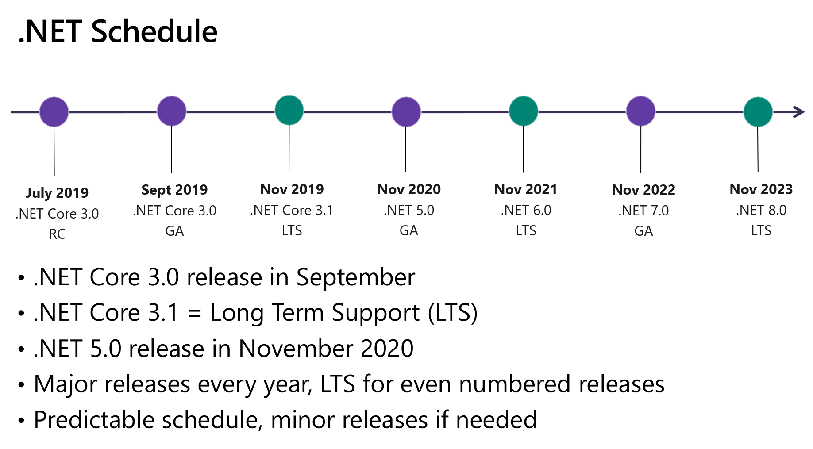
ROADMAP
https://github.com/dotnet/core/blob/master/roadmap.md

Slide 9
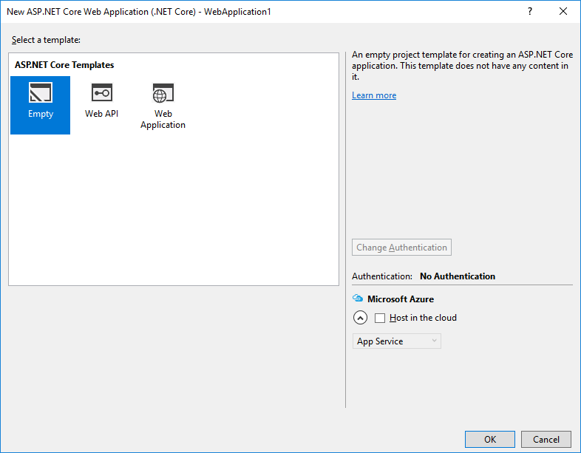
GETTING STARTED – PROJECT TEMPLATES 2015

Slide 10
GETTING STARTED – PROJECT TEMPLATES 2017
Empty Template
Provides the bare minimum folders and files for an ASP.NET web site, such as a project file (.csproj or .vbproj), project.json and a Web.config file.
Web API Template
Creates a sample web service based on Web API 2
Web Application Template
Creates a sample web application that uses JavaScript, HTML 5, and client side technology on the client, and ASP.NET Web API 2 on the server

Slide 11
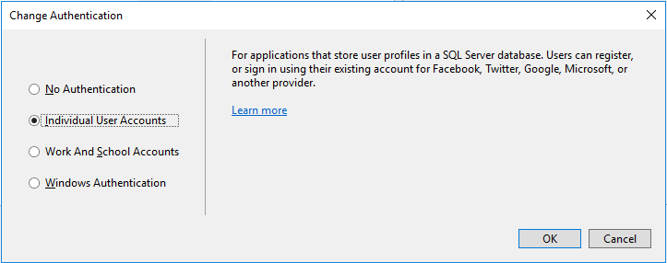
PROJECT TEMPLATE - AUTHENTICATION
No Authentication
The sample application will contain no web pages for logging in, no UI indicating who is logged in, no entity classes for a membership database, and no connection string for a membership database.
Individual User Accounts
The sample application will be configured to use ASP.NET Identity (formerly known as ASP.NET membership) for user authentication.
ASP.NET Identity enables a user to register an account, by creating a username and password on the site or by signing in with social providers such as Facebook, Google, Microsoft Account, or Twitter.
The default data store for user profiles in ASP.NET Identity is a SQL Server LocalDB database.

Slide 12
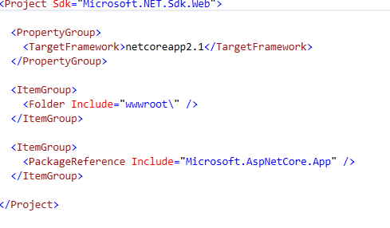
GETTING STARTED
Project file
.csproj or .vbproj depending on programing
language used.
No need to unload the project and edit the file
File folder references is no longer included in
file.
The file system determines what files and
folders belongs to project
Target Framework Moniker(TFM)
.Net framework –net451,net472…
.Net Core –netcoreapp2.1,netcoreapp2.2

Slide 13
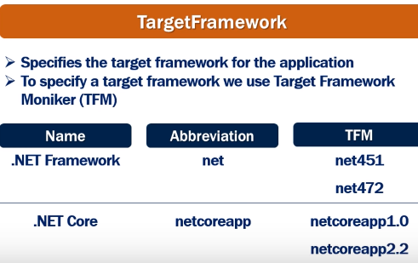
Target Framework

Slide 14
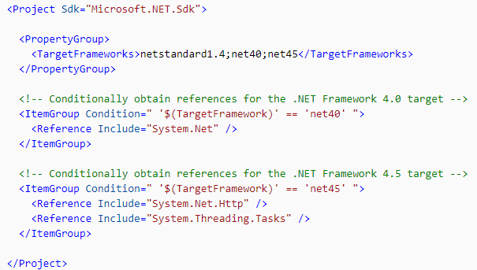
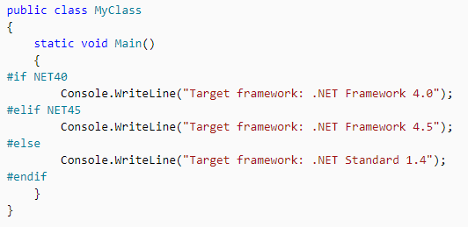
Conditional References

Slide 15
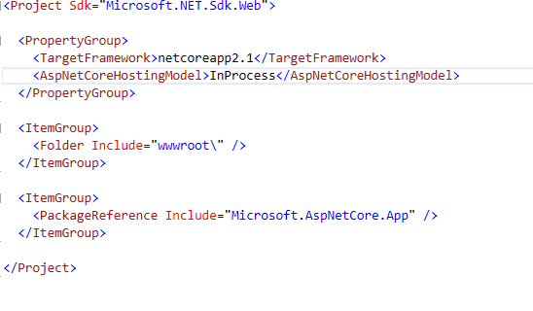
Project File
Project file
AppNetCoreHostingModel
InProcess or OutOfProcess
InProcess hosts the app inside of the
IIS Worker process(w3wp.exe)
OutOfProcess Hosting model Forward
to a backed ASP.NET core app running
the Kestrel server

Slide 16
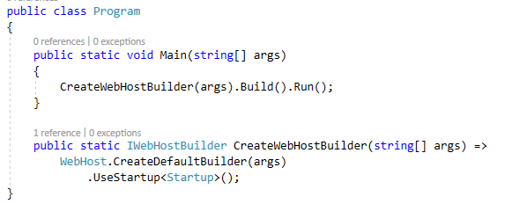
Main Method
Webhost create the IWebhostBuilder instance
Build method will, host the web application
Run method will run web application and
start listen the http request.

Slide 17
InProcess Hosting
CreateDefaultBuilder()
Setting up the web server
Loading the host and application configuration from various configuration sources
Configuration logging
InProcess Hosting
CreateDefaultBuilder() method calls UseIIS() method and host the app inside the IIS worker process (w3wp.exe or issexpress.exe)
InProcess hosting delivers significantly higher request throughput than the OutProcess hosting.
There is only one web server in case of InProcess hosting
From a performance standpoint, InProcess hosting is better than OutOfProcess hosting.

Slide 18
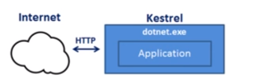
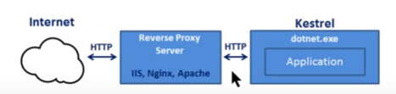
OutOfProcess Hosting
Kestrel
Cross-Platform webserver for .Net core
Kestrel can be used by itself as an edge sever
Kestrel can be used as the internet facing web server
Kestral can be used in combination with a proxy server IIS….
The process used to host the app is dotnet.exe
OutOfProcess Hosting
If there is not AspNetCoreHostingModel tag then by default it will take as OutOfProcess hosting
If we ran application from VS, by default it will run on IISexpress
What is advantage of reverse proxy server
It will provide additional configuration and security

Slide 19
InProcess v/s OutOfProcess Hosting
InProcess | OutOfProcess
Process name is w3wp.exe or issexress.exe | dotnet.exe
Only one web server | Two webservers
Better performance | Penalty of proxying requests between internal and external webservers

Slide 20
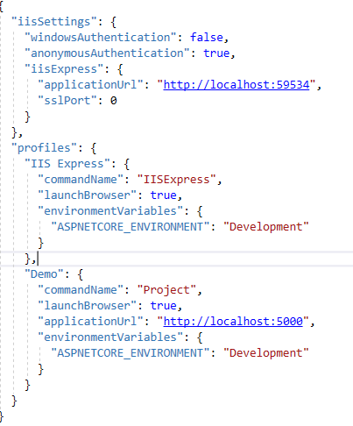
Launchsetting json

Slide 21
appsettings.json
Configuration sources in .Net core
Fies(appsettings.json,appsettings.{environment}.json)
User secrets
Environments
Command line arguments
To access configuration information
IConfiguration Service
https://github.com/aspnet/MetaPackages/blob/release/2.2/src/Microsoft.AspNetCore/WebHost.cs
Method ConfigureAppConfiguration

Slide 22
Q and A

Slide 23
Thank You

